Slide 1
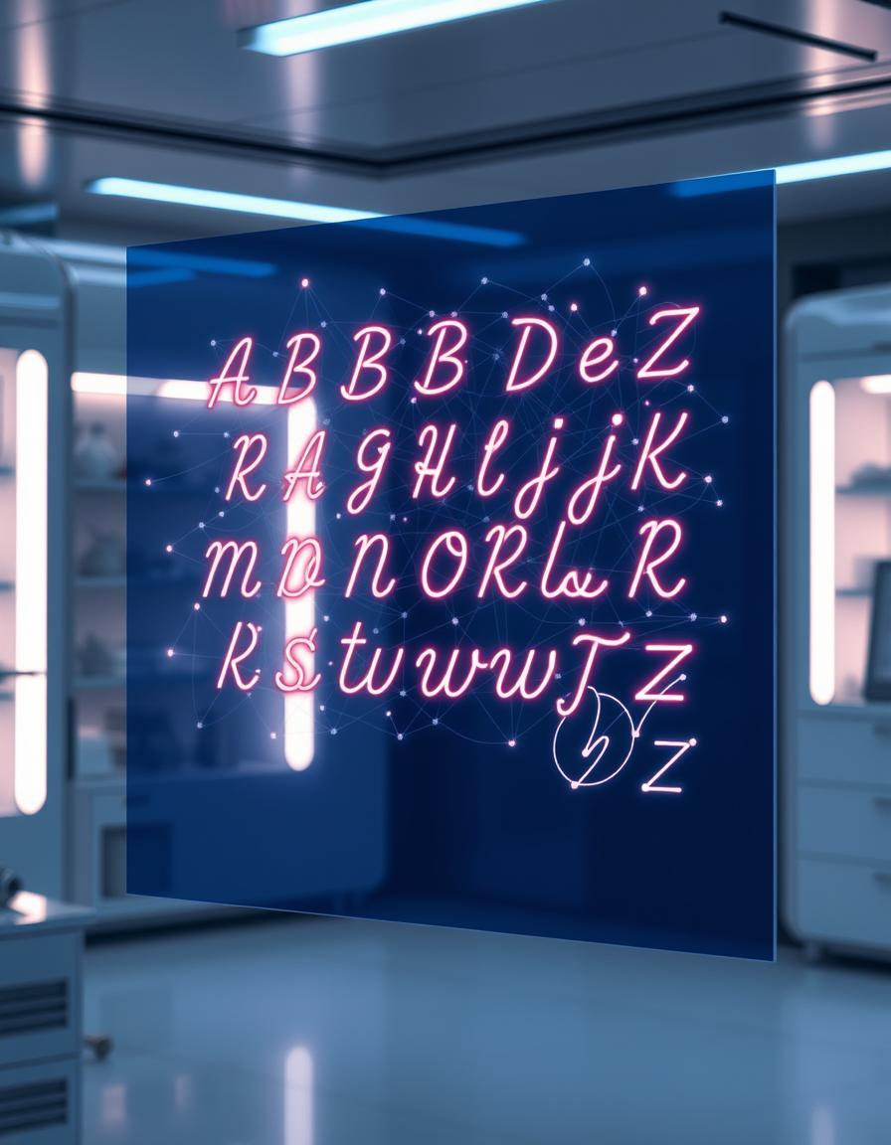
Handwritten Alphabet Recognition: A Deep Learning Approach
Utilizing CNNs, RNNs, and Hybrids for accurate character identification.
Team Member:
Adithya Vardhan Reddy
1

Slide 2
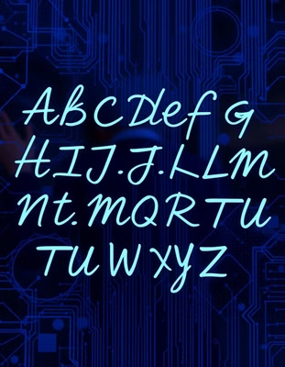
Introduction
Handwritten Alphabet Recognition is a crucial task in AI-driven document processing, accessibility tools, and automated grading systems.
Traditional OCR methods struggle with the high variability in human handwriting styles, leading to misclassification.
Deep Learning techniques, particularly Convolutional Neural Networks (CNNs) and Recurrent Neural Networks (RNNs), offer a data-driven approach to improve accuracy.
This project aims to develop a high-precision AI model capable of recognizing handwritten English alphabets (A-Z, a-z) with robust generalization across different writing styles.
2

Slide 3
Motivation
To address the limitations of traditional OCR methods in accurately recognizing handwritten alphabets due to variability in writing styles.
Deep Learning models can learn complex patterns and variations in handwriting, offering a superior alternative.
Exploring CNNs, RNNs, and hybrid models can push the boundaries of handwriting recognition technology.
To develop a robust deep learning model that can generalize well across different handwriting styles, improving accuracy and reliability in applications such as
3

Slide 4
Objectives
Major Objectives:
Develop a high-accuracy deep learning model for handwritten alphabet recognition (A-Z, a-z).
Ensure robustness against handwriting variations in size, slant, and style.
Implement transfer learning & ensemble methods for improved model generalization.
Deploy the model in a real-time inference system for practical use cases.
Minor Objectives:
Collect and preprocess handwritten alphabets to create a diverse dataset.
Tune hyperparameters and apply regularization techniques (Dropout, BatchNorm).
Use accuracy, precision, recall, and F1-score to compare models.
Implement Grad-CAM to understand model decisions.
4

Slide 5
Problem Statement
The vast variability in handwriting styles, influenced by individual differences and writing tools, makes accurate recognition difficult.
Misclassification affects document digitization, accessibility, and automated form processing.
Traditional OCR struggles to generalize across different handwriting styles, reducing reliability.
Achieving high accuracy and robustness requires data-driven learning approaches.
5

Slide 6
Suggested Solution
Deep Learning techniques offer a powerful, data-driven approach to overcome these challenges, enabling the development of robust and accurate handwriting recognition systems.
Implement a Deep Learning-based approach using Convolutional Neural Networks (CNNs) and Recurrent Neural Networks (RNNs) for handwritten alphabet recognition.
Leverage transfer learning and ensemble methods to enhance model accuracy and generalization across different handwriting styles.
Apply data preprocessing and augmentation techniques to handle variations in handwriting, improving model robustness.
Conduct extensive performance evaluation using accuracy, precision, recall, and F1-score to ensure reliable classification.
Deploy the trained model into a real-time inference system for practical applications such as OCR, automated grading, and accessibility tools.
6

Slide 7
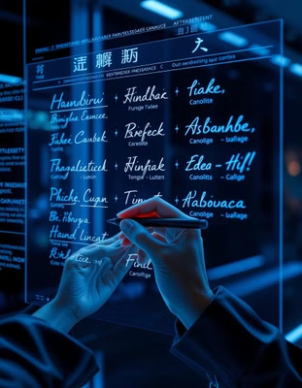
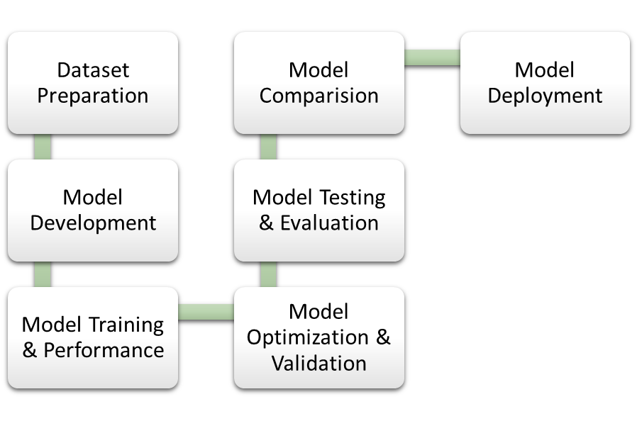
Methodology Overview
7

Slide 8
Dataset Overview
Custom Handwritten Dataset created using MS Paint to ensure diversity in handwriting styles.
Contains uppercase (A-Z) and lowercase (a-z) English alphabets, covering 52 classes.
Images saved in PNG format to maintain quality and consistency.
Data Preprocessing:
Grayscale Conversion – Removes color information.
Resizing – Standardizes all images for model.
Normalization – Scales pixel values between 0 and 1 for efficient learning.
Data Augmentation Techniques Applied:
Rotation – Handles slanted writing styles.
Translation & Scaling – Mimics real-world handwriting variations.
Dataset Split:70% Training | 15% Validation | 15% Testing
8

Slide 9
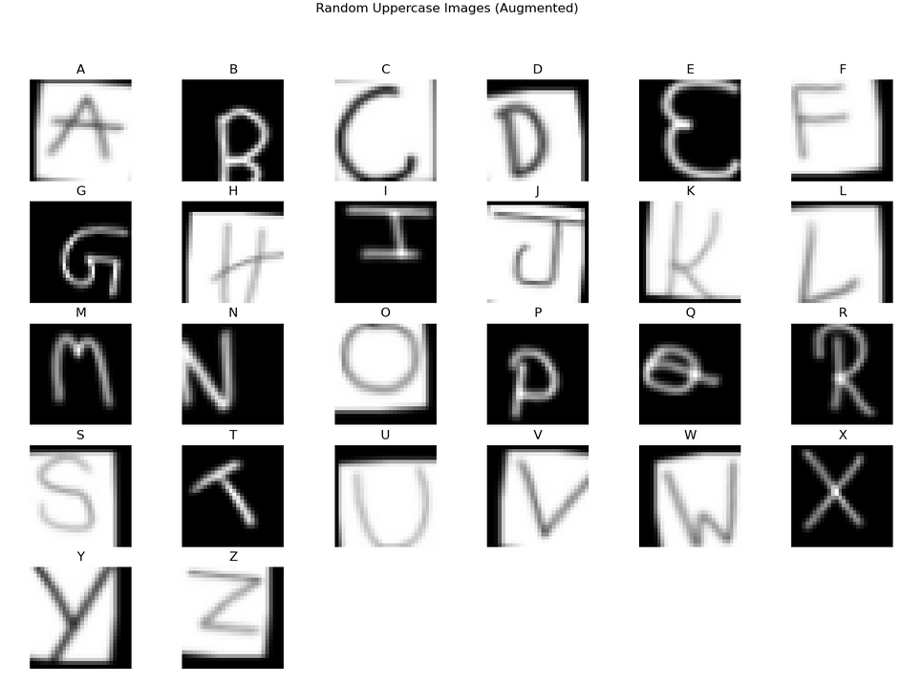
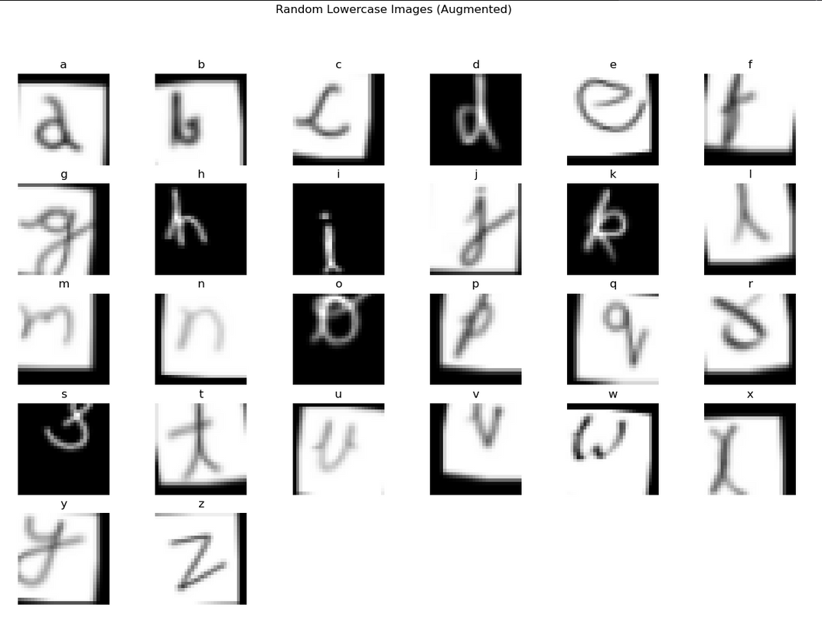
Dataset Overview
9

Slide 10
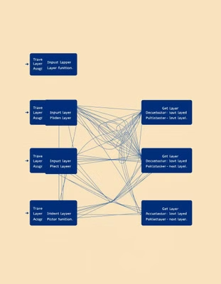
Neural Network Architecture
Implement CNNs, RNNs, and hybrid models to extract spatial and sequential features from handwritten alphabets.
CNN Models:
LeNet-5: Lightweight, efficient for small-scale classification.
VGG-16: A deeper network leveraging small filters for enhanced feature learning.
RNN Models:
LSTM: Captures long-term dependencies in sequential handwriting patterns.
GRU: A computationally efficient alternative to LSTM.
Hybrid Models (CNN + RNN):
LeNet5-GRU: Uses LeNet-5 for spatial feature extraction and GRU for sequence modeling.
VGG16-GRU: Combines pre-trained VGG-16 with GRU for advanced feature learning.
Input: Handwritten character images (64×64 pixels, grayscale).
Output: 52-class classification (A-Z, a-z) using Softmax activation.
10

Slide 11
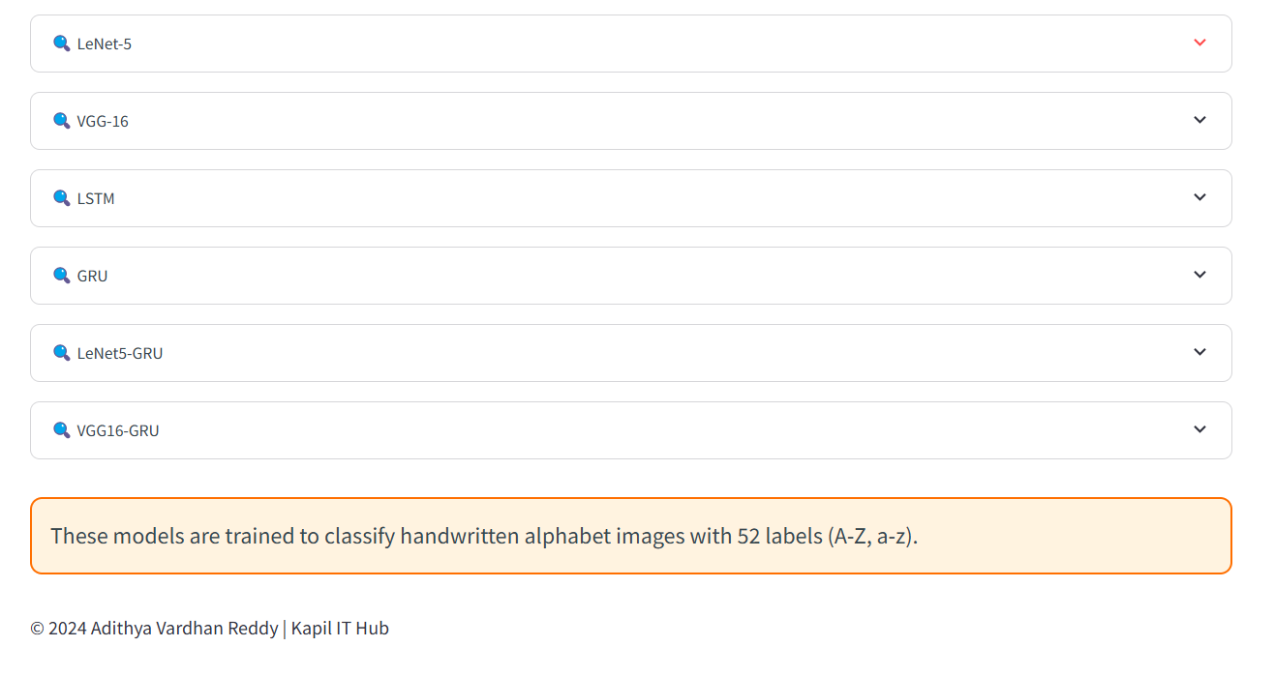
Neural Network Architecture
11

Slide 12
Model Training & Performance
Data Preprocessing: Grayscale conversion, normalization, augmentation (rotation, scaling, translation).
Training Setup:
Loss Function: Categorical Cross-Entropy.
Optimizers: Adam.
Performance Metrics:
Training & Validation Loss vs. Accuracy Curves.
Confusion Matrix for error analysis.
Comparison of different models on training data.
Regularization Methods:
Dropout
Batch Normalization
12

Slide 13
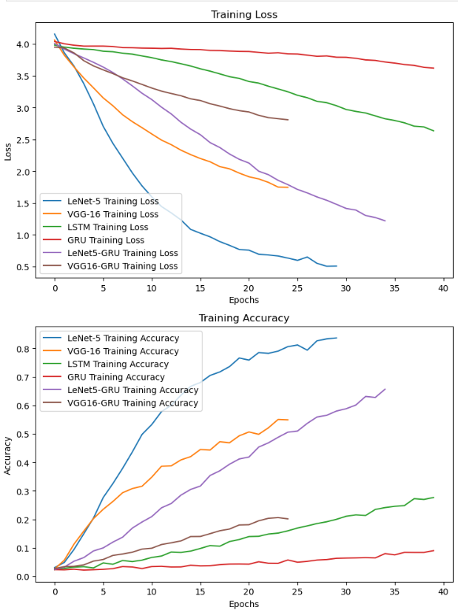
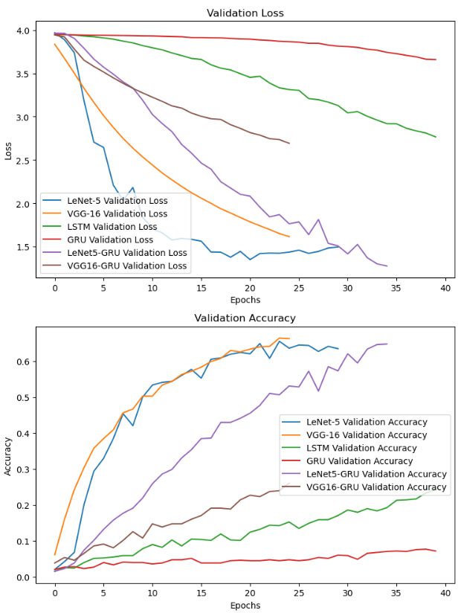
13

Slide 14
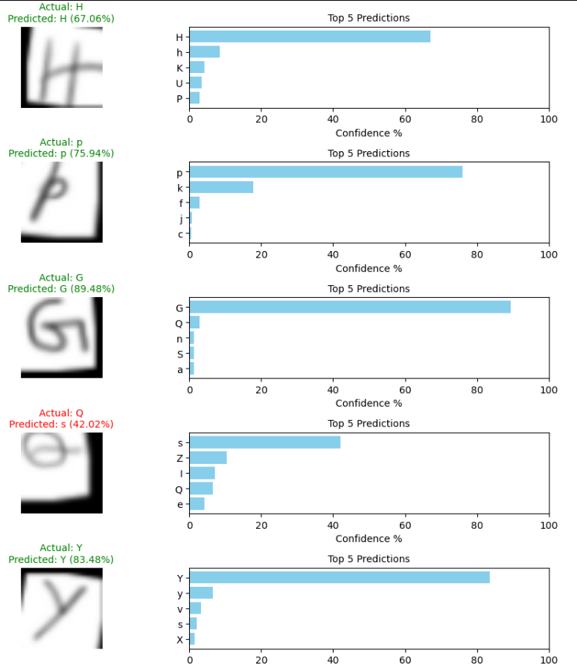
14

Slide 15
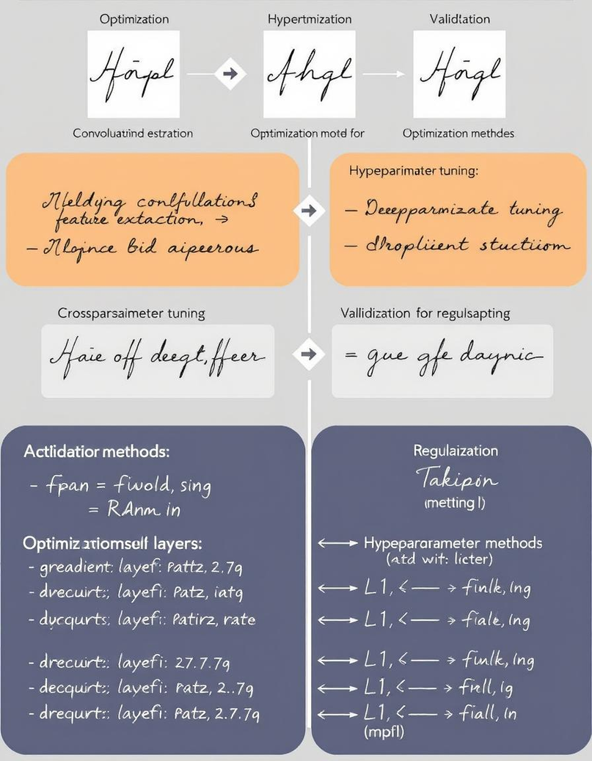
Model Optimization & Validation
Hyperparameter Tuning:
Learning Rate, Dropout, Batch Size, Number of Layers.
Random Search for optimal settings.
Regularization Methods:
Dropout
Batch Normalization
Optimization Techniques:
EarlyStopping
ModelCheckpoint
ReduceLROnPlateau
15

Slide 16
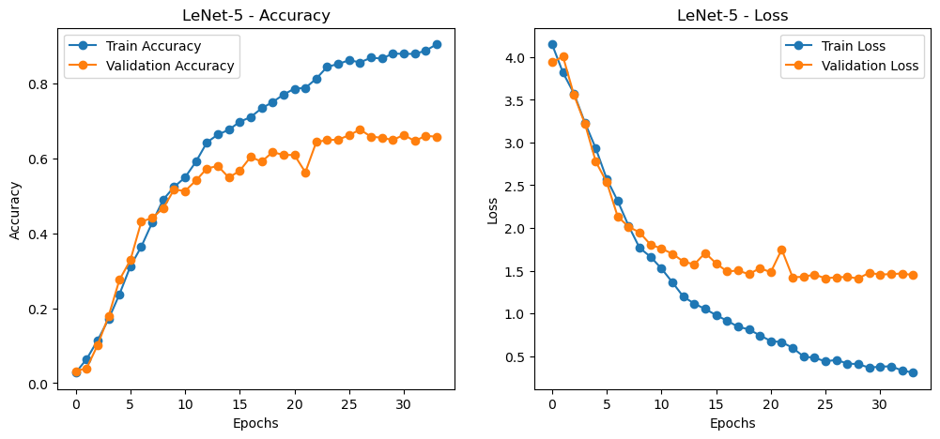
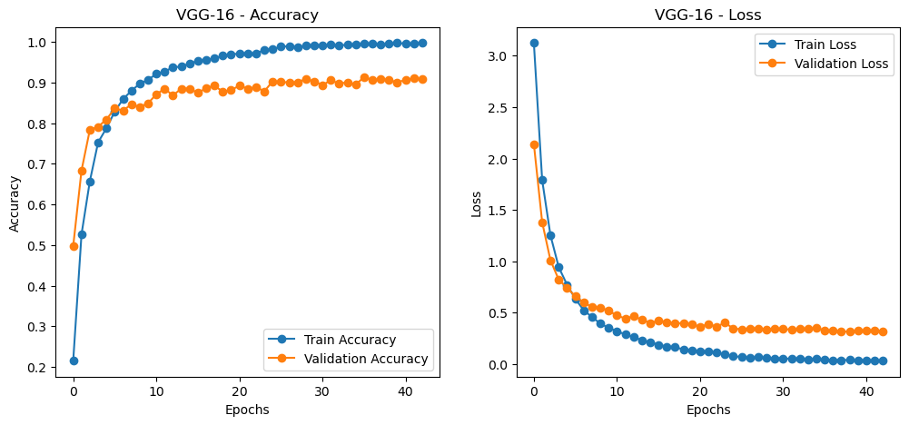
16

Slide 17
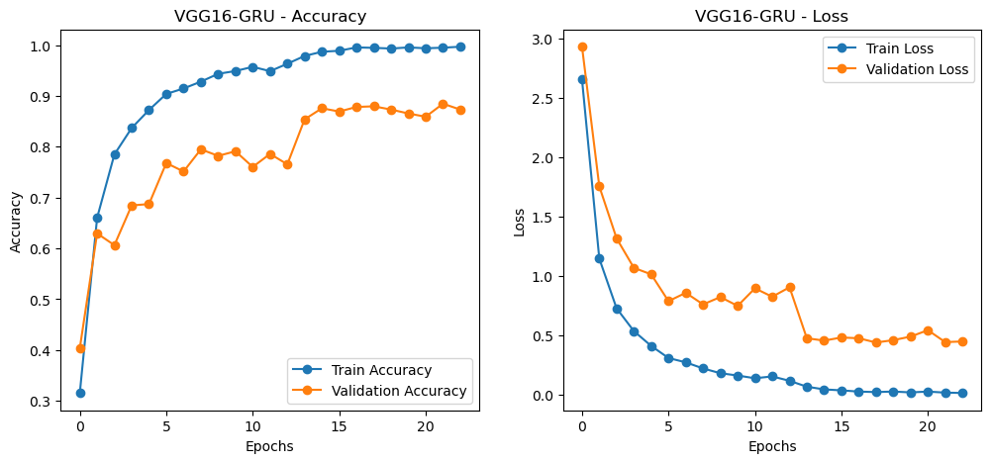
17

Slide 18
Model Testing & Evaluation
Testing Setup:
Testing Dataset: Held-out test set (15% of data).
Evaluation Metrics:
Accuracy Score
Precision Score
Recall Score
F1 Score
Prediction Analysis:
Actual vs. Predicted labels.
Confidence scores for predictions.
Input: Handwritten character images (64×64 pixels, grayscale).
Output: 52-class classification (A-Z, a-z) using Softmax activation.
18

Slide 19
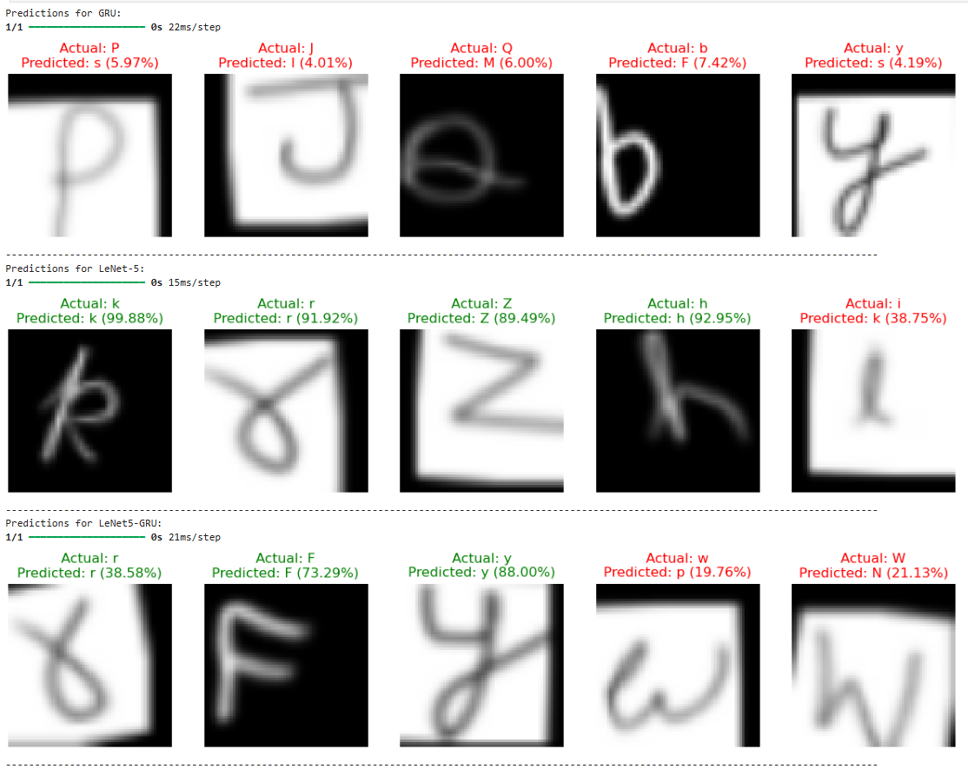
Model Testing
(Non-tuned)
19

Slide 20
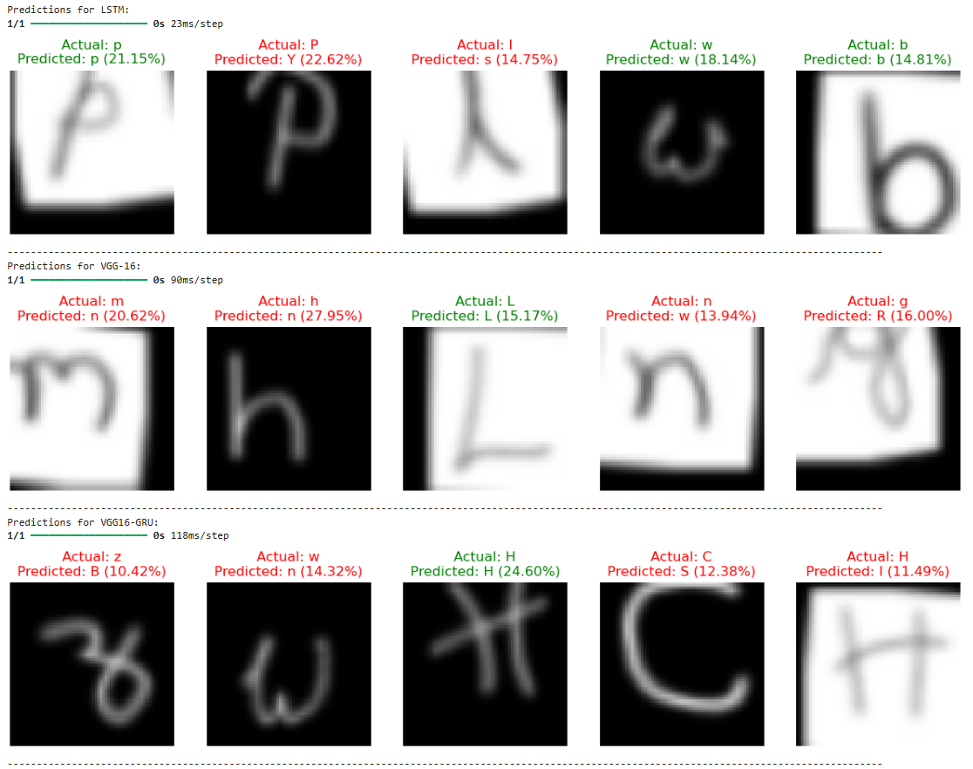
Model Testing
(Non-tuned)
20

Slide 21
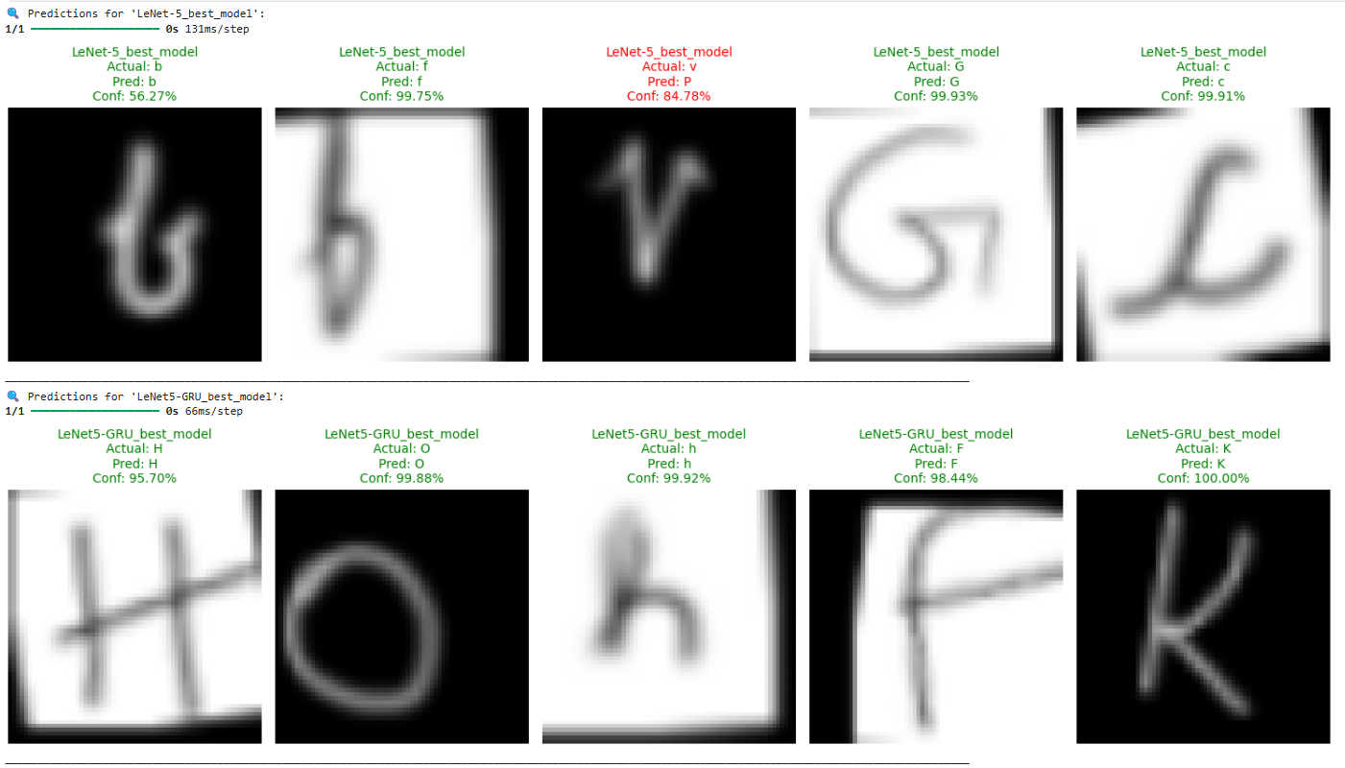
Model Testing
(Tuned)
21

Slide 22
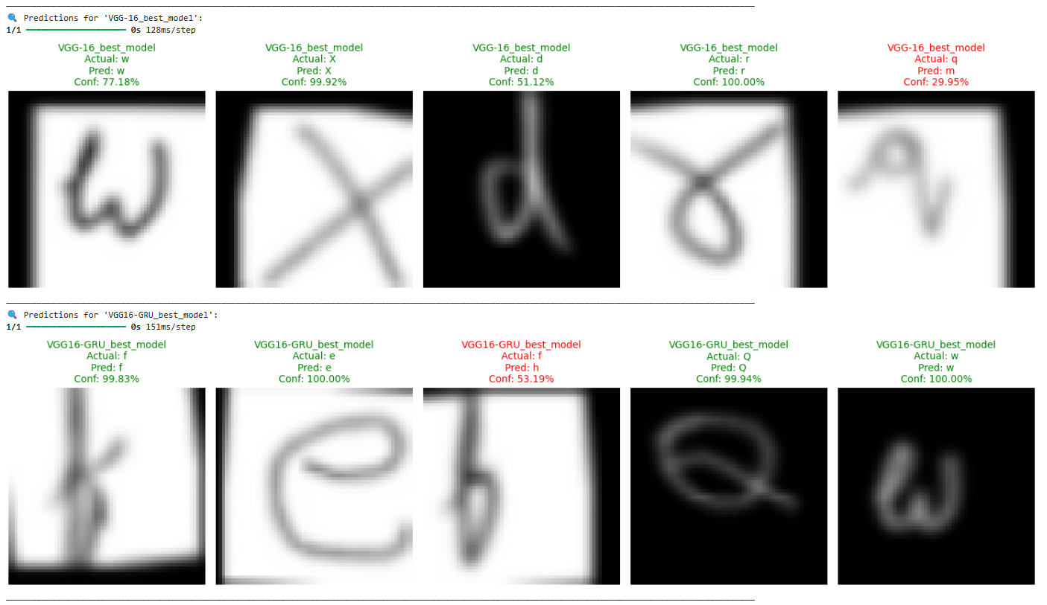
Model Testing
(Tuned)
22

Slide 23
Model Comparision
Models:
Tuned Models (4): LeNet-5, VGG-16, LeNet5 ~ GRU, VGG16 ~ GRU
Non-Tuned Models (6): LeNet-5, VGG-16, LeNet5 ~ GRU, VGG16 ~ GRU, LSTM, GRU
Performance Metrics:
Training Loss vs. Accuracy Curves
Validation Loss vs. Accuracy Curves
Evaluation Metrics:
F1 Score
Accuracy
Recall
Precision
23

Slide 24
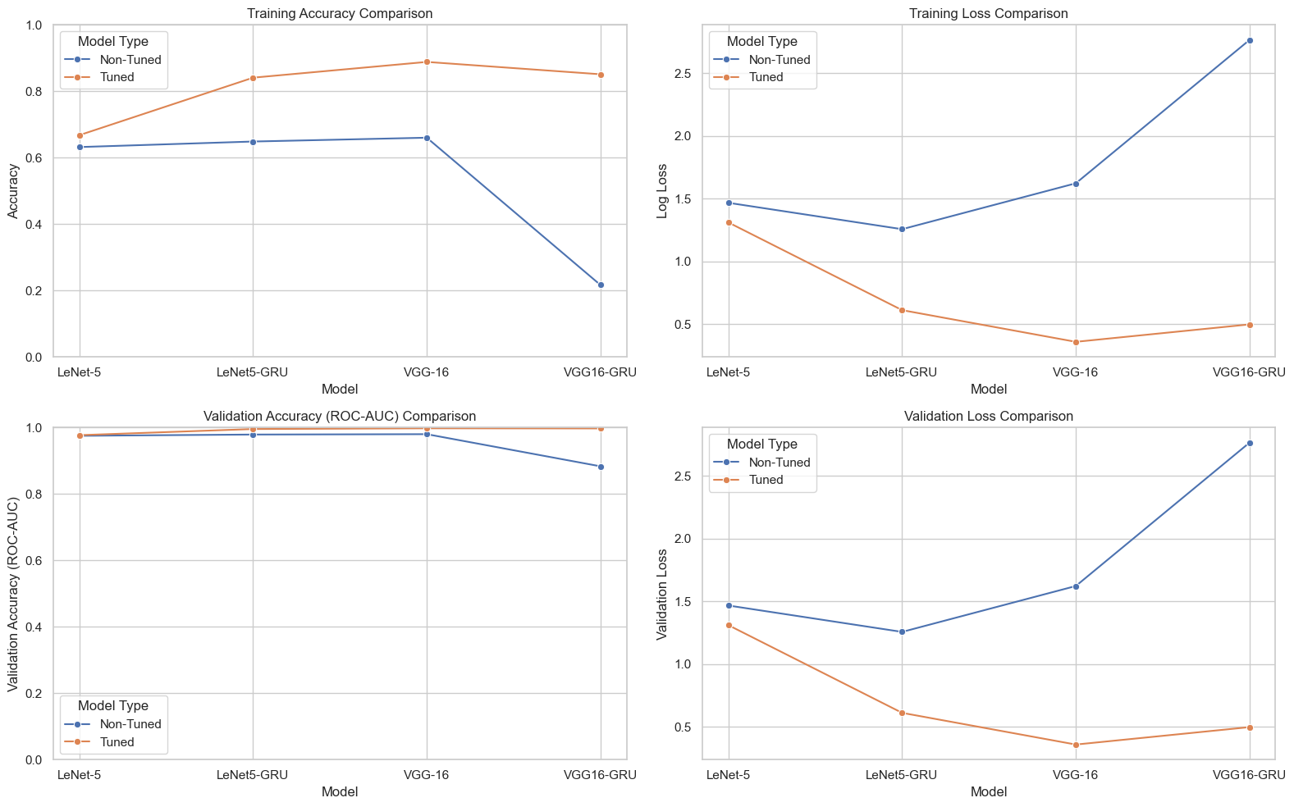
24

Slide 25
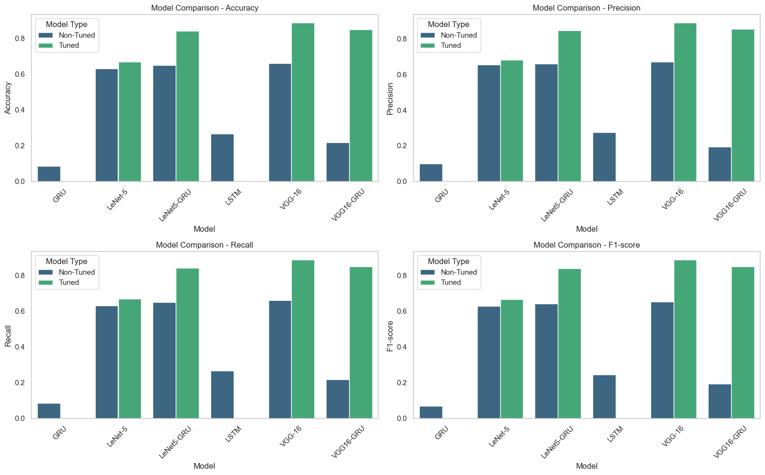
25

Slide 26
Model Deployment
Deployment Strategy:
Web-based Streamlit App for real-time handwriting recognition.
Backend powered by TensorFlow/Keras for inference.
User Interface Features:
Upload handwritten image for recognition.
Displays predicted character with confidence score.
26

Slide 27
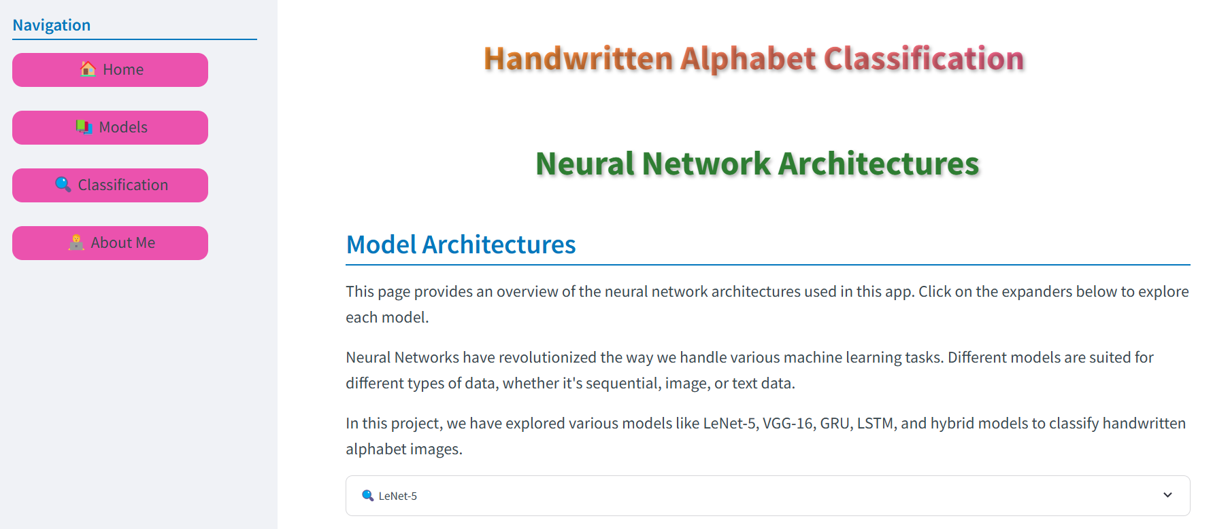
Model Deployment
27

Slide 28
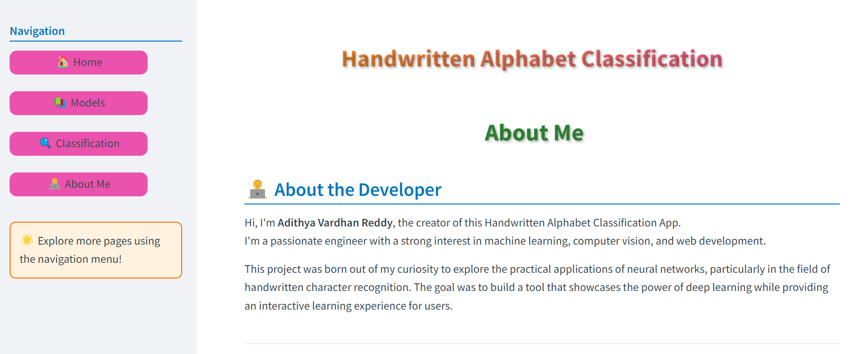
Model Deployment
28

Slide 29
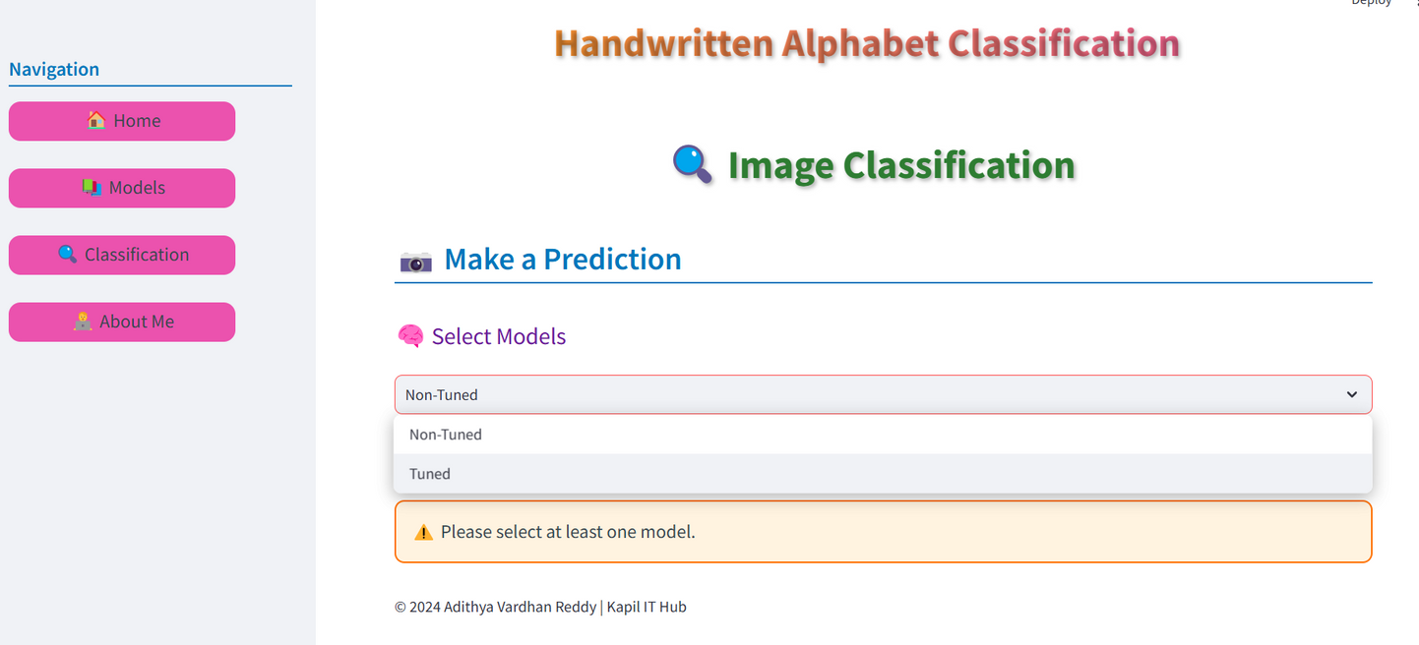
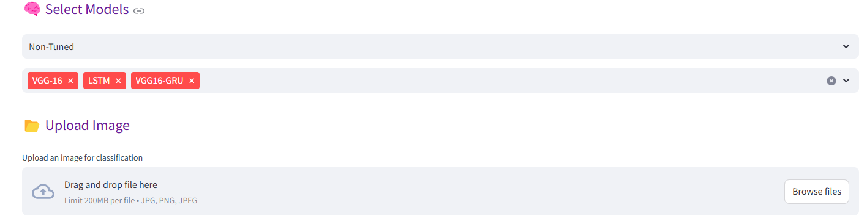
29

Slide 30
Result
Model Performance Summary:
The tuned VGG-16 model demonstrated the highest performance across all metrics (Accuracy, Precision, Recall, F1-score).
Hyperparameter tuning consistently improved model performance across all architectures.
The VGG16-GRU model was very dependent on being tuned.
Deployment Success:
All 10 models (tuned and non-tuned) were successfully deployed using Streamlit.
This deployment enables real-time testing and practical application of the developed models.
The Streamlit application provides an accessible interface for users to interact with the handwriting recognition system.
30

Slide 31
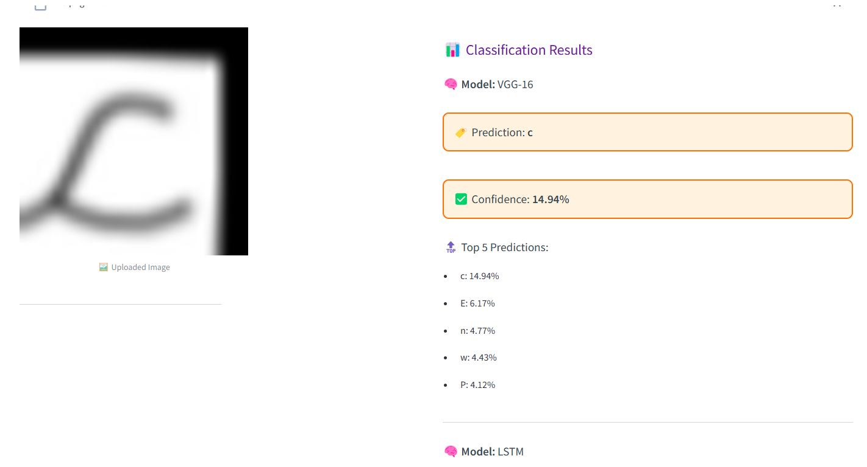
Result
31

Slide 32
Challenges & Learnings
Challenges:
Handling Diverse Handwriting Styles
Dataset Imbalance
Computational Constraints
Hyperparameter Tuning Complexity
Deployment
Learning:
High-Quality Data is More Important Than Model Complexity
Optimized Learning Rate & Hyperparameter Tuning Made a Big Difference
Transfer Learning is a Time-Saver
Real-World Testing is Essential
32

Slide 33
Future Work
Multilingual Handwriting Recognition
Handwritten Word & Sentence Recognition
Self-Learning & Continual Model Improvement
Large-Scale Deployment
Expanding Dataset for Better Generalization
33

Slide 34
Conclusion
This project successfully developed a deep learning model capable of accurately recognizing handwritten English alphabets.
Hyperparameter tuning proved crucial in achieving optimal model performance.
The tuned VGG-16 model demonstrated exceptional accuracy, making it a promising candidate for real-world applications.
This technology has the potential to revolutionize various fields, including education, document processing, and accessibility.
Future work will focus on exploring more advanced techniques and expanding the scope of the model.
34

Slide 35
References
Online Courses & Video Resources
Krish Naik (YouTube Channel) – Deep Learning, Computer Vision, and Model Optimization Tutorials.
Sentdex (YouTube Channel) – Python Machine Learning & Deep Learning for OCR.
Official Documentation & Frameworks
TensorFlow Documentation – Guides on CNNs, RNNs, Transfer Learning & Model Deployment.
Keras Documentation – Deep Learning APIs for building & training models.
Publicly Available Handwriting Datasets
EMNIST Dataset – Extended MNIST dataset containing handwritten letters & digits.
NIST Special Database 19 – Large-scale U.S. government dataset for handwritten character recognition.
Kaggle - English Handwritten Characters
35

Slide 36

Question & Answer
36

